Slide 1

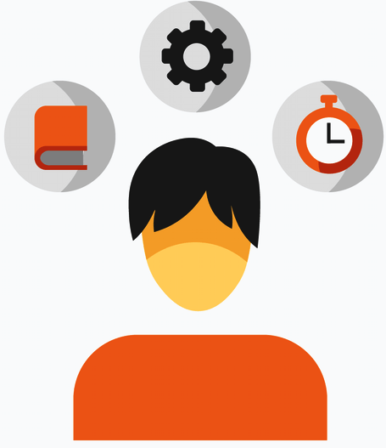
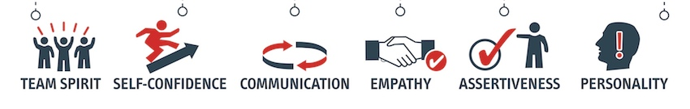
Soft-Skills Exploration
(AI Solution)
Team member ( Group 10 )
Anurag Sharma (100799864)
Aman Verma (100799391)
Kartik Jagdish Sojitra (100723768 )

Slide 2
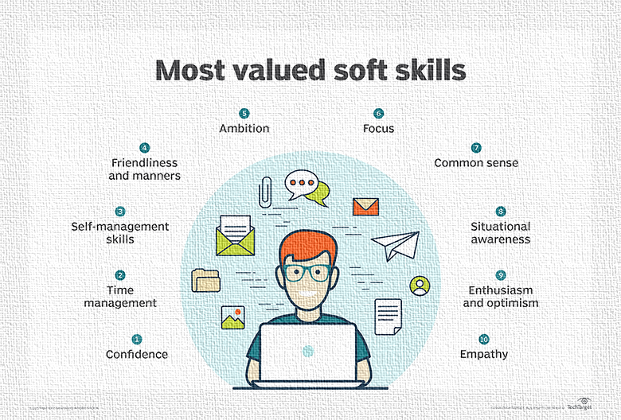
Objective
Personality plays a key role in predicting many factors of an individual such as mental and physical health, career fit, and well-being.
Hence, getting a deep insight into a person’s soft-skills is of key importance.

Slide 3

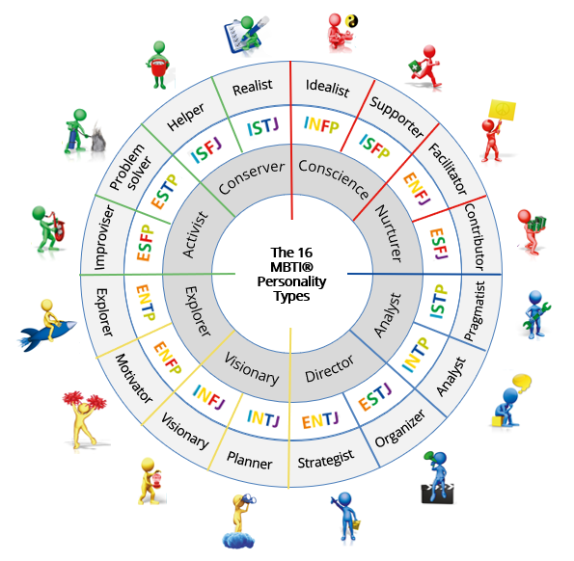
Myers Briggs Classification Problem
Theory of psychological types described by C. G. Jung was transformed into 16 indicators by Isabel Briggs Myers, and her mother, Katharine Briggs.
The Myers Briggs Type Indicator (or MBTI for short) is a personality type system that divides everyone into 16 distinct personality types across 4 axes:
Introversion (I) – Extroversion (E)
Intuition (N) – Sensing (S)
Thinking (T) – Feeling (F
Judging (J) – Perceiving (P)

Slide 4
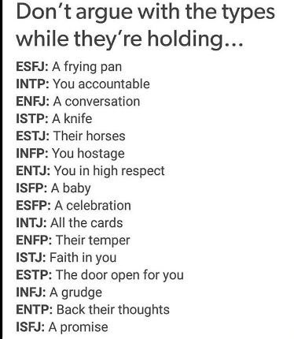
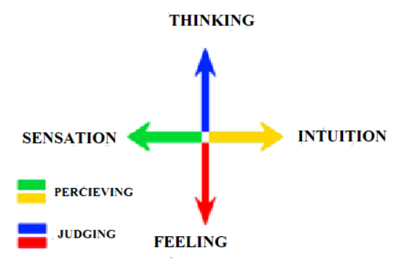
Myers Briggs Indicators

Slide 5

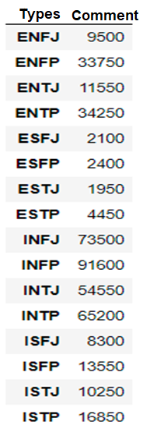
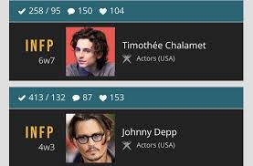
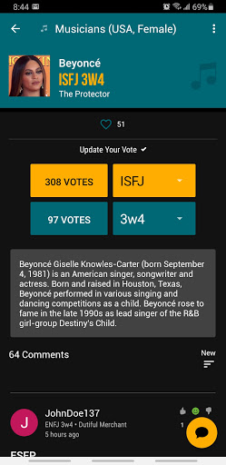

Data Science Component
The dataset from Personality Cafe online is composed of 8675 unique users each with their 4 letter MBTI code along with 50 post utterances. The distribution of the data by type is displayed on the right.
“(MBTI) Myers-Briggs Personality Type Dataset”, contains
• Type (This person 4 letter MBTI code/Type)
• A section of each of the last 50 things they have posted (Each entry separated by “|||” (3 pipe characters))

Slide 6
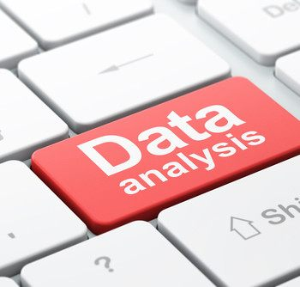
Data Analysis Approach
It is a scenario of Supervised Learning where Natural Language Processing Approach will be used.
This would require classification algorithms like Logistic Regression, KNN, and Random Forest, and try to understand the accuracy.
This model will also classify people into MBTI personality types based on their past 50 posts on social media using the basic Naive Bayes Classifier.

Slide 7





Software Tool Used
The software tools used will be: -
Python – for EDA (Exploratory Data Analysis), Data Cleaning, Model Building, and Testing
Jupyter Notebook – IDE for development
Tableau/Power BI – for detailed visualizations
Flask
Database MySQL

Slide 8
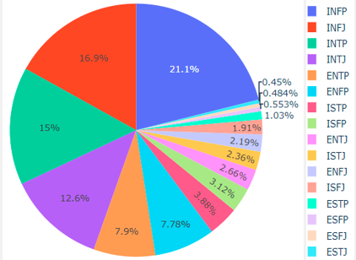
Exploratory Data Analysis

Slide 9
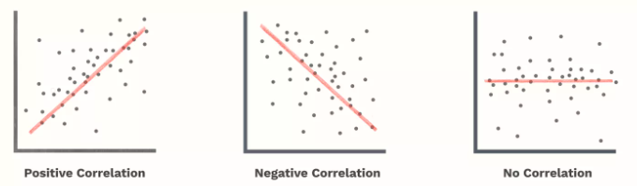
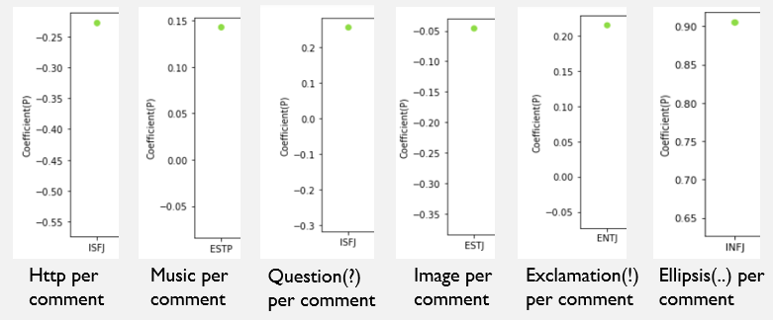
EDA Continued
Pearson’s Correlation Coefficient
The correlation coefficient (ρ) is a measure that determines the degree to which the movement of two different variables is associated.

Slide 10
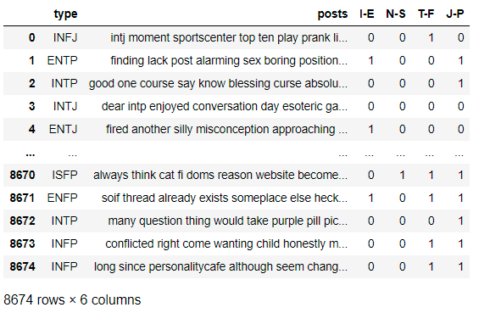
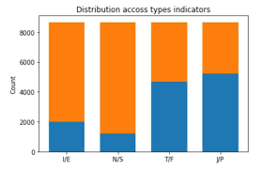
Data preprocessing
To get a further insight on our dataset, creating 4 new columns dividing the people by introversion/extroversion, intuition/sensing, and so on.
When it comes to performing machine learning, distinguish between two categories is much easier than distinguishing between 16 categories.

Slide 11
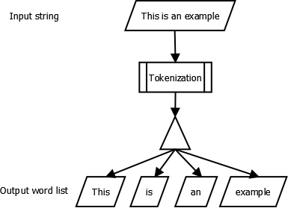
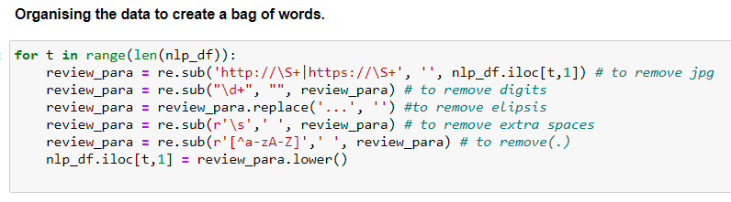
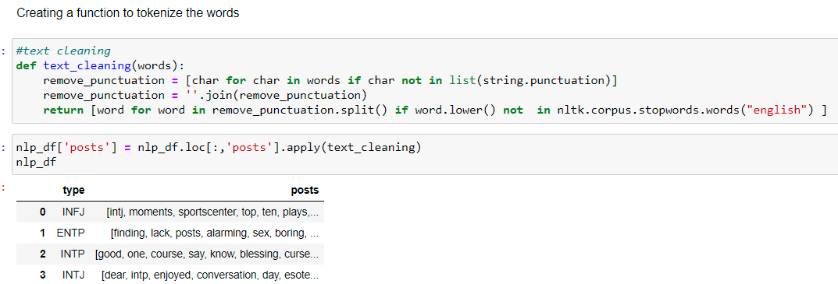
Tokenization - Vectorization

Slide 12
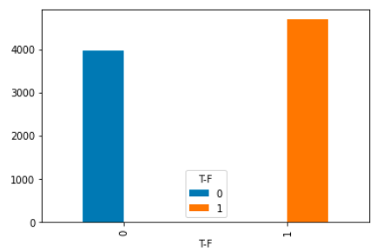
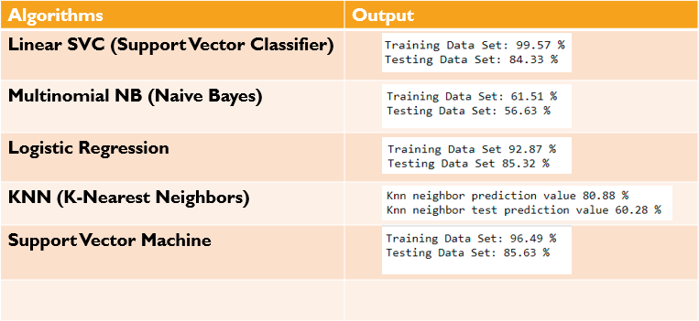
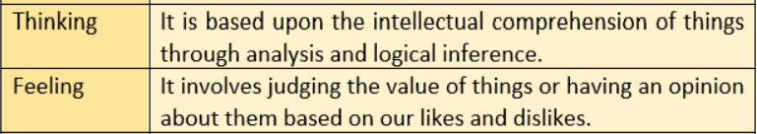


Data Modelling: Machine Learning

Slide 13
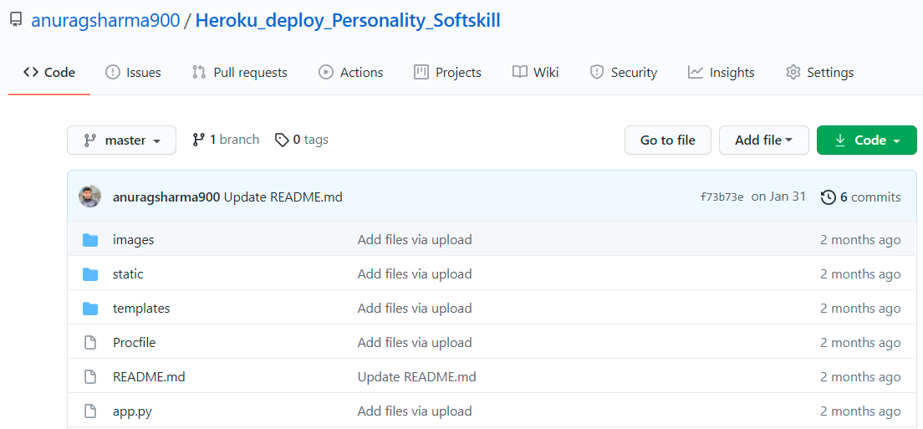
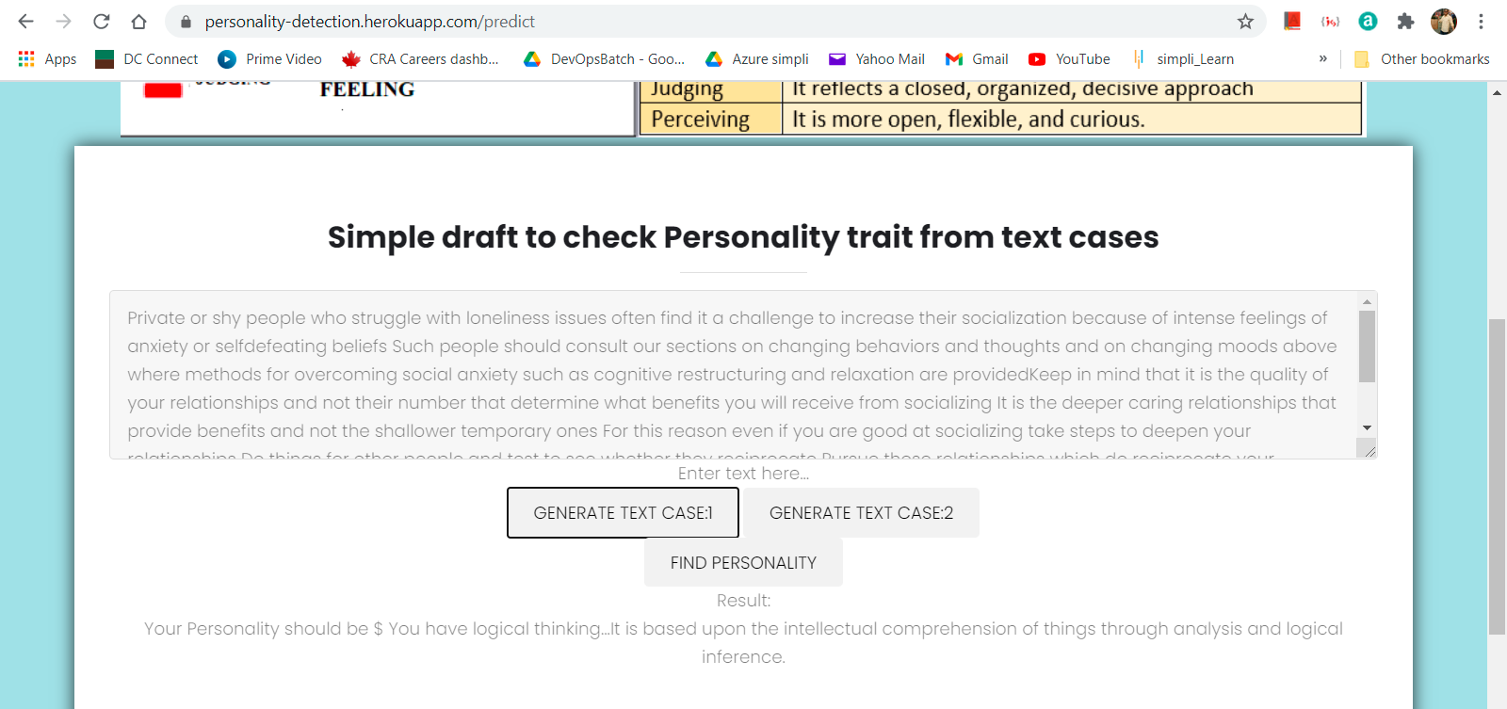
Deployment
GitHub link
https://github.com/anuragsharma900/Heroku_deploy_Personality_Softskill
Heroku Deployment
https://personality-detection.herokuapp.com

Slide 14
Time plan of project activities and deliverables
Timeline | Activities | Deliverables
2021-03-15 | Problem statement. Data requirements. | Statement of Work
2021-03-22 | Perform exploratory data analysis Data Cleaning , Pre-Processing. | Data Analysis
2021-03-29 | Evaluate learning algorithms | Model Creation
2021-03-29 | Feeding data Observe output. | Prototype Solution
2021-04-05 | Upload a document on GitHub. Heroku Deployment. | Deployment
2021-04-08 | Project Demo and Video Presentation (12 -15 Min) Submission. Project Report Submission.

Slide 15
Conclusion
The ‘Personality Test Model’ based on MBTI assessment from social media comment data would predict the relevance of the famous MBTI system. The purpose is to see if any patterns can be detected in specific types and their style of writing, which overall explores the validity of the test in analyzing, predicting, or categorizing behavior and later testing the models to predict the personality by feeding a few of the writings.
THANK
YOU

